Slide 1

NeuroDOT 2.2.0 Base
Tutorial - Overview

Slide 2
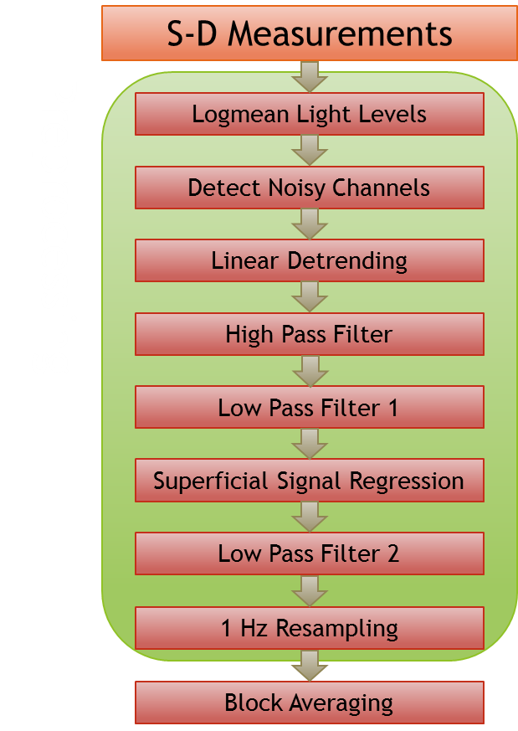
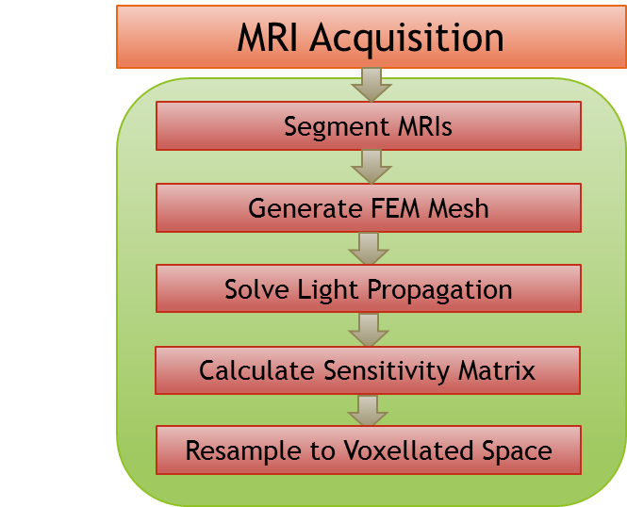
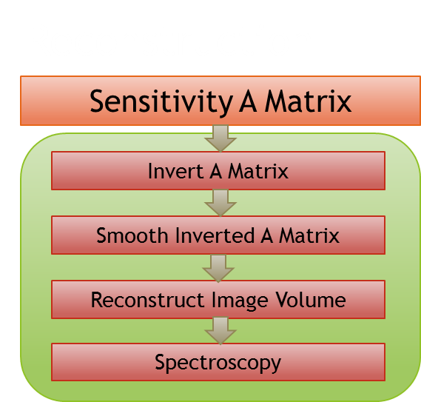
NeuroDOT 2 Overview Flowchart

Slide 3
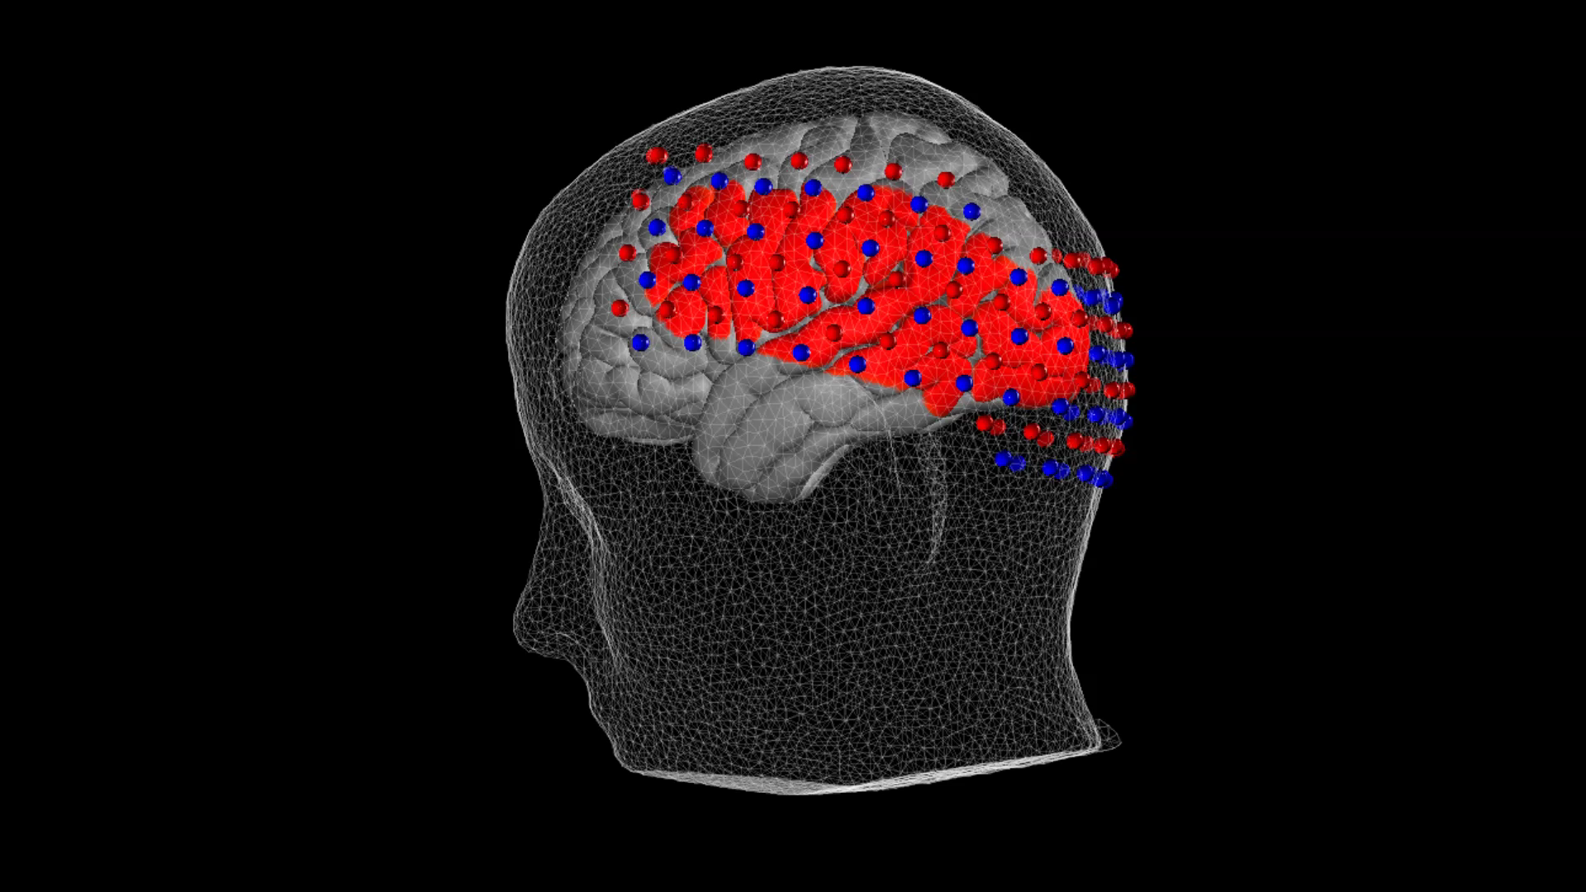
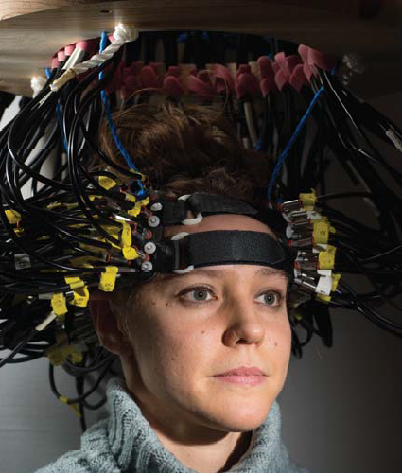
Intro to NeuroDOT 2.2.0
Welcome to NeuroDOT 2.2.0 Base! (ND2 for short) This tutorial will teach you the basics of NeuroDOT toolbox.

Slide 4

Diffuse Optical Tomography
In diffuse optical tomography (DOT), cap arrays of optical sources and detectors are used to perform functional neuroimaging experiments.
These experiments are broken into several components pipelines: preprocessing of the raw source-detector (S-D) measurements, modeling of the light emission, diffusion, and detection through the head, reconstruction and spectroscopy of the preprocessed data and light model into a functional neuroimaging volume, and analysis of these results.
These pipelines allow a variety of experimental paradigms to be investigated.

Slide 5
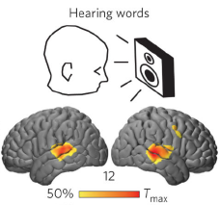
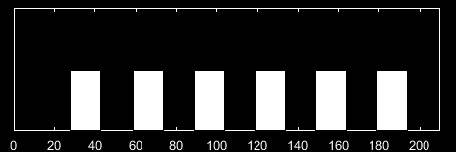
Mapping Hearing Words
In the hearing words (HW) paradigm, which we will use in this tutorial, a participant quietly listens to auditory stimuli presented through speakers.
The stimuli are divided into six 30-second blocks (white rectangles on bottom-right), with one spoken word per s for 15 s, followed by 15 s of silence.
These blocks are averaged together and reconstructed into a 5D time series movie of brain function: 3 dimensions of space, 1 dimension for time, and 1 dimension for Hemoglobin contrasts: oxy, deoxy, and total.

Slide 6
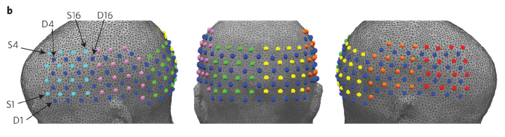
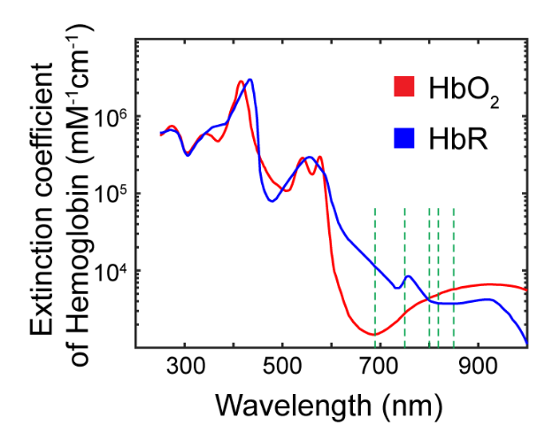
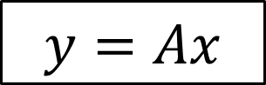
Reconstructing Image Volumes
After block averaging, we must reconstruct our measurement pairs into an image volume. This is done by applying a Tikhonov inversion to a linear Rytov approximation. What this ultimately means is that in the equation at right, our measurements correspond to y, our sensitivity matrix is A, and the desired image volume is x.
NN1
NN2
NN3
NN4
NN5
$$y=Ax$$
After the reconstruction, we use the differing extinction coefficients of deoxy- and oxy-hemoglobin (HbO and HbR, respectively) at our two wavelengths (750 and 850 nm) to isolate each concentration from the other and calculate functional neural activity maps.

Slide 7
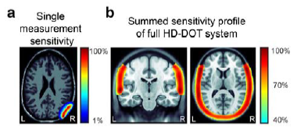
HD-DOT Sensitivity Profile
On the right is a sensitivity profile for a single source-detector pair (a), and for the entire HD-DOT large cap system (b), which was used to gather the measurements we are using for our examples in this tutorial.
The summed sensitivity profile in (b) also essentially gives us our field of view (FOV) for the system. Note that this FOV overlaps with tissue superficial to the brain of the underlain atlas, such as scalp and skull.

Slide 8
Lists of Files and Functions
In this section, you will find complete lists of all files and functions contained in NeuroDOT 2.2.0 Base.

Slide 9
List of Documentation Files
NeuroDOT 2.2.0 Base Quick Start Guide.pptx
/Documentation
/readme.txt
/NeuroDOT 2.2.0 Base User Manual.docx
/Appendices
/Sample Results
/NeuroDOT 2.2.0 Base Appendix - AC Sample Results.pptx
/NeuroDOT 2.2.0 Base Appendix - GV Sample Results.pptx
/NeuroDOT 2.2.0 Base Appendix - HW Sample 2 Results.pptx
/NeuroDOT 2.2.0 Base Appendix - HW Sample Noisy Results.pptx
/NeuroDOT 2.2.0 Base Appendix - RW Sample Results.pptx
/NeuroDOT 2.2.0 Base Appendix - Atlases.pptx
/NeuroDOT 2.2.0 Base Appendix - File IO.pptx
/NeuroDOT 2.2.0 Base Appendix - Pipeline Diagrams.pptx
/NeuroDOT 2.2.0 Base Appendix - Preprocessing Pipeline Analysis.pptx
/MATLAB_Help_Files
/Scripts
/NeuroDOT_Base_DOT_Processing_Script.m
/NeuroDOT_Base_Preprocessing_Pipeline_Script.m
/NeuroDOT_Base_Reconstruction_Pipeline_Script.m
/Tutorials
/NeuroDOT 2.2.0 Base Tutorial - Overview.pptx
/NeuroDOT 2.2.0 Base Tutorial - DOT Processing Pipeline.pptx
* This sample is the primary subject of the tutorials.

Slide 10
List of Data and Support Files
/Data
/NeuroDOT_Base_AC_Sample.mat
/NeuroDOT_Base_CCW_Sample.mat
/NeuroDOT_Base_CW_Sample.mat
/NeuroDOT_Base_GV_Sample.mat
/NeuroDOT_Base_HW_Sample_1.mat*
/NeuroDOT_Base_HW_Sample_2.mat
/NeuroDOT_Base_HW_Sample_Noisy.mat
/NeuroDOT_Base_IN_Sample.mat
/NeuroDOT_Base_OUT_Sample.mat
/NeuroDOT_Base_RW_Sample.mat
/HOMER_Sample
/test_homer2.nirs
/ND1_Sample
/NeuroDOT_Base_Converter_Sample.mat
/Raw_Samples
/AC_Sample/
/CCW_Sample/
/CW_Sample/
/GV_Sample/
/HW_Sample_1/
/HW_Sample_2/
/HW_Sample_Noisy/
/IN_Sample/
/OUT_Sample/
/RW_Sample/
/Support_Files
/Raw_Support_Files/
/Spectroscopy/E.mat
/A_Adult_96x92.mat
/Atlas_MNI152nl_T1_on_111.mat
/Atlas_MNI152nl_T1_on_333.mat
/Atlas_Segmented_MNI152nl_T1_on_111.mat
/Atlas_Segmented_MNI152nl_T1_on_333.mat
/Cap_Fitter_Mesh_Sample.mat
/LR_Meshes_MNI_164k.mat
/Pad_Adult_96x92.mat
/Pad_AdultV24x28.mat
/Pad_Baby32x34.mat
* This sample is the primary subject of the tutorials.

Slide 11
List of Functions (1)
/Functions
/Analysis
/BlockAverage.m
/FindGoodMeas.m
/File_IO
/Check4MissingData.m
/converter_data.m
/converter_HOMER_to_ND2.m
/converter_info.m
/converter_ND1_to_ND2.m
/converter_ND2_to_HOMER.m
/converter_ND2_to_ND1.m
/Crop2Synch.m
/InterpretPulses.m
/InterpretStimSynch.m
/InterpretSynchBeeps.m
/Load_AcqDecode_Data.m
/Load_HOMER.m
/LoadMulti_AcqDecode_Data.m
/LoadVolumetricData.m
/Make_NativeSpace_4dfp.m
/Read_4dfp_Header.m
/Read_AcqDecode_Header.m
/Read_NIFTI_Header.m
/ReadAux.m
/ReadInfoTxt.m
/Save_HOMER.m
/SaveVolumetricData.m
/Write_4dfp_Header.m
/Write_NIFTI.m
/GUIs
/Cap_Fitter.fig, /Cap_Fitter.m
/operate_optodes.m
/springfit_optodes.m
/Reconstruction
/reconstruct_img.m
/smooth_Amat.m
/spectroscopy_img.m
/Tikhonov_invert_Amat.m

Slide 12
List of Functions (2)
/Functions
/Spatial_Transforms
/affine3d_img.m
/change_space_coords.m
/Good_Vox2vol.m
/rotate_cap.m
/rotation_matrix.m
/scale_cap.m
/Support
/CheckOrientation.m
/istablevar.m
/Temporal_Transforms
/detrend_tts.m
/fft_tts.m
/gethem.m
/highpass.m
/logmean.m
/lowpass.m
/normalize2range_tts.m
/regcorr.m
/resample_tts.m
/Visualizations
/adjust_brain_pos.m
/applycmap.m
/PlotCap.m
/PlotCapData.m
/PlotCapGoodMeas.m
/PlotCapMeanLL.m
/PlotFalloffData.m
/PlotFalloffLL.m
/PlotGray.m
/PlotGrayData.m
/PlotHistogramData.m
/PlotHistogramSTD.m
/PlotInterpSurfMesh.m
/PlotLLFalloff.m
/PlotLRMeshes.m
/PlotMeshSurface.m
/PlotPowerSpectrumAllMeas.m
/PlotPowerSpectrumData.m
/PlotPowerSpectrumMean.m
/PlotSlices.m
/PlotSlicesMov.m
/PlotSlicesTimeTrace.m
/PlotTimeTraceAllMeas.m
/PlotTimeTraceData.m
/PlotTimeTraceMean.m
/vol2surf_mesh.m

Slide 13
Data Structures
In this section are detailed descriptions of all data structures and their elements.

Slide 14
Data Structures
There are three variables in the sample file “NeuroDOT_Base_HW_Sample_1.mat”:
data – A “MEASUREMENTS x TIME” array of raw optical light-level measurements acquired from a study participant during a hearing words test.
info – A structure array containing metadata about cap information like wavelengths, topography, the system, experimental scheme, and the light model, which are required to convert the raw light-level measurements into 3D time series (AKA movies) of brain activity.
flags - A structure array containing instructions for functions in the pipeline.

Slide 15
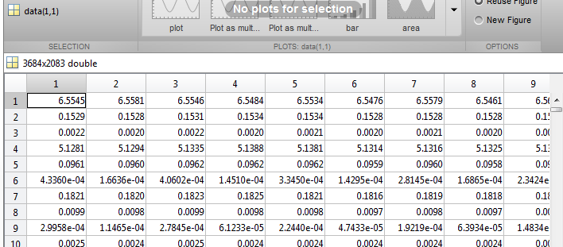
Data Structures: data
Each row of data corresponds to a source-detector pair. Each column is one frame or sample of the acquisition period.

Slide 16
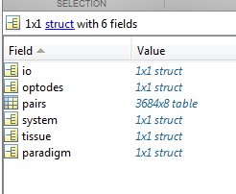
Data Structures: info
There are eight fields in info:
io - (optional) Information loaded during file IO but not used in ND2.
system - Metadata of system used to collect scan data from cap.
paradigm - Metadata describing experimental design.
pairs - Table describing source-detector measurements.
optodes - Geometry of imaging cap.
tissue - Information about light modeling.
MEAS - ("on-the-fly") A table of data generated along MEAS dimension.
misc - (optional) Information kept from ND1 structures during file conversion.

Slide 17
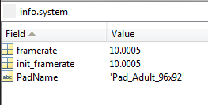
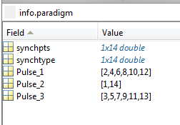
In Detail: info.system and info.paradigm
info.system
PadName - Name of the Pad_[xxxx].mat file used to create info.pairs, info.optodes, and info.tissue.
framerate - Current framerate of data being processed.
init_framerate - Original framerate of data at time of acquisition.
info.paradigm
synchpts - Time points of synch pulses detected.
init_synchpts - A backup of the original synch points.
synchtype - Frequency of the pulses detected.
Pulse_1 - Indices of session start and stop times within synchpts
Pulse_2 – Indices of block start times within synchpts
Pulse_3/Pulse_4 – Indices of extra stimuli or rest pulses within synchpts.

Slide 18
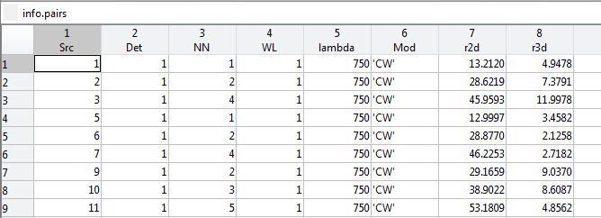
In Detail: The info.pairs table
Each row represents a measurement.
The columns are:
Src – Source number
Det – Detector number
NN – Nearest neighbor topology
WL – Wavelength number
lambda - Wavelength in nm
Mod - Modulation scheme
r2d – S-D pair radius on a 2D grid
r3d - S-D pair radius in 3D wrapped cap space
NN1
NN2
NN3
NN4
NN5

Slide 19
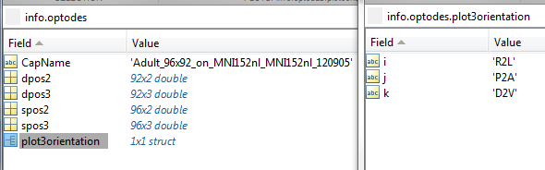
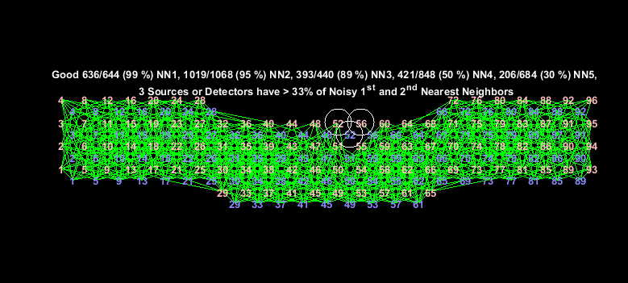
In Detail: info.optodes
CapName - Name of cap file used.
dpos2 - Detector positions in 2D grid space.
spos2 - Source positions in 2D grid space.
dpos3 - Detector positions in 3D wrapped cap space.
spos3 - Source positions in 3D wrapped cap space.
plot3orientation - Contains .i, .j, and .k fields corresponding to x, y, and z orientation of 3D wrapped cap space.
Left: 2D grid space.
Right: 3D wrapped cap space.

Slide 20
In Detail: info.tissue
info.tissue
affine - A transform matrix relating the DOT space to the atlas space.

Slide 21
Data Structures: flags
The flags structure has 11 fields:
Nsys - Number of systems used to acquire data.
crop_level - Determines data cropping to synch points. 0 – none, 1 – start pulse, 2 – start and stop pulses. Default 0 for Nsys == 1, and 2 for Nsys >= 2.
bthresh – Noise threshold for Good Measurements analysis.
gbox – Gaussian smoothing filter width.
gsigma – Gaussian smoothing filter height.
lambda1 – First Tikhonov regularization parameter.
lambda2 – Spatially variant Tikhonov regularization parameter.
omega_hp – HPF frequency.
omega_lp1 – First LPF frequency.
omega_lp2 – Second LPF frequency.
omega_lp3 – Third LPF frequency.
omega_resample – Resampling frequency.
resample_tol – Tolerance threshold for resampling ratio

Slide 22
Data Structures: params & header
params is used by most of the visualizations in NeuroDOT 2. Please see the appendix section at the end of this presentation, the function help sections, or the User Manual index for details on which functions use which fields.
header is the NeuroDOT 2 native 4dfp format header for volumetric data.

Slide 23
Data Structures: params (1)
params
fig_size - Figure position vector.
fig_handle - Figure to target.
dimension - Plot rendering dimension.
rlimits - Limits of pair radii displayed.
Nnns - Number of NN's displayed.
Nwls - Number of WL's displayed.
useGM – Whether to use Good Measurements.
xlimits – Y-axis limits.
xscale – X-axis scaling.
ylimits – Y-axis limits.
yscale – Y-axis scaling.
climits - Limits of color axis.
mode – Display mode.
Nregs - Number of mesh regions to display.
cbmode - Use custom colorbar axis labels.
cblabels - Custom colorbar axis labels.
cbticks - Custom colorbar axis label ticks.
bins - Number or array of histogram bins.
show_pulses - Whether to display stim synch pulses.

Slide 24
Data Structures: params (2)
params
CH - Turn crosshairs on and off.
slices - Selects 3D slices to display.
slices_type - Selects MATLAB indexing or coordinates in provided space for slices.
orientation - Selects 3D orientation to display.
view – Sets the view perspective.
ctx – Defines inflation of a mesh.
alpha – Transparency of mesh.
OL – If “overlap” data is presented (OL==1), this sets the interpolation method to 'nearest'. Default is 'linear'.
DR - Grayscale dynamic range.
Scale - Maximum value to which an image is scaled.
BG - Background color, as an RGB triplet.
TC - True color mapping.
PD - Declares a positive definite data set.
Cmap - Colormap settings.
P - Positive domain colormap.
N - Negative domain colormap.
flipP - Inverts positive colormap.
flipN - Inverts negative colormap.
Th - Threshold settings structure.
P - Basemum threshold to display positive values.
N - Maximum threshold to display negative values.
Saturation - Field the size of data with values to set the coloring saturation. Must be within range [0, 1].

Slide 25
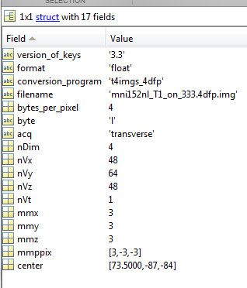
Data Structures - header
header
version_of_keys - Key file version.
format - Format of raw data file (“float”, “double”, etc.).
conversion_program - Program used to convert the space.
filename - Name of associated raw volumetric data file.
bytes_per_pixel - Number of bytes per pixel.
byte - Byte endian-ness.
acq - Canonical orientation of the data's raw space.
nDim - Number of dimensions.
nVx, nVy, nVz - Number of voxels in each spatial dimension.
nVt - Number of time points.
mmx, mmy, mmz - Size of voxels in millimeters, in each dimension.
mmppix - Number of millimeters per voxel in each dimension (x, y, z). A negative value reflects that the direction is flipped in that dimension.
center - A vector projecting from the center of voxel (0, 0, 0) to the center of the space described by header.

Slide 26
Data Structures - mesh
mesh - A 3D surface mesh object
nodes - A NODES x 3 column vector where each row represents the X, Y, and Z coordinates of a polygon vertex on the surface.
elements - An ELEMENTS x 3 column vector where each row represents the index of three NODES that create a polygon in 3D space.
data - An optional NODES x 1 array containing an interpolation of volumetric data at each node.
region – An optional NODEs x 1 array of region labels.

Slide 27
Data Structures - ops
ops – A structure containing results from the Cap_Fitter GUI.
rot_x, rot_y, rot_z – Rotation angles in each spatial dimension.
trans_x, trans_y, trans_z – Translation in each spatial dimension.
flip_x, flip_y, flip_z – Flip axes in each spatial dimension.
scale_m – Scaling factor.

Slide 28
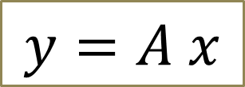
Data Structures
$$y=A x$$
The NeuroDOT 2 file A_Adult_96x92.mat contains several variables for reconstuction:
A - A MEAS x VOX sized pre-determined sensitivity matrix.
dim - A structure describing the DOT reconstruction space.
infoA - A 4dfp header describing the sensitivity modeling space.

Slide 29
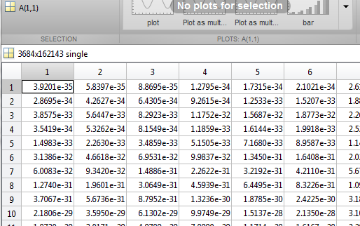
Data Structures - A
Each row of A corresponds to a measurement channel in data.
Each column in A corresponds to a voxel in the reconstruction space described by dim.

Slide 30
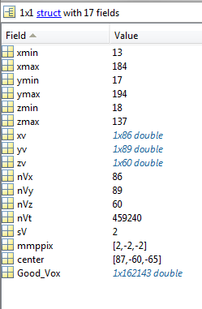
Data Structures - dim
dim
xmin, xmax, ymin, ymax, zmin, zmax - Min and max coordinates in each dimension of the sensitivity matrix space.
xv, yv, zv - Coordinates of each voxel along each dimension.
nVx, nVy, nVz - Number of voxels in each dimension.
nVt - Total number of voxels in the space.
sV - Isometric voxel size, in millimeters.
mmppix - Number of millimeters per voxel in each dimension (x, y, z). A negative value reflects that the direction is flipped in that dimension.
center - A vector projecting from the center of voxel (0, 0, 0) to the center of the space described by dim.
Good_Vox - Voxels of the full cuboid volume described by dim that are populated with data in the associated data array.

Slide 31
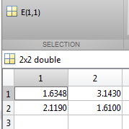
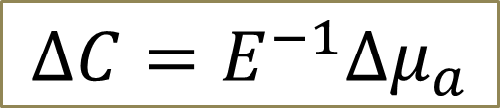
Data Structures
The last thing we'll need is a matrix of spectroscopy constants to satisfy the modified Beer-Lambert law.
This is stored in: /Support_Files/Raw_Support_Files/Spectroscopy/E.mat The lone variable, E, is a 2 x 2 (WL x HB) matrix of spectroscopy constants for HbO and HbR.
$$∆C=E^{−1}∆μ_{a}$$

Slide 32
Function Descriptions
In this section, the functions of each folder are listed and described.

Slide 33
Analysis
Name | Purpose
BlockAverage | Averaging of stimulus blocks.
FindGoodMeas | Filter out noisy channels.

Slide 34
File IO (1)
Name | Purpose
Check4MissingData | Validates framesynch file against key file info.
Crop2Synch | Crops data to synch points.
converter_data | Reshapes data from ND1 to ND2 format.
converter_HOMER_to_ND2 | Converts workspace from HOMER to ND2.
converter_info | Converts the ND1 info structure to ND2 format.
converter_ND1_to_ND2 | Converts both data and info from ND1 format to ND2.
converter_ND2_to_HOMER | Converts workspace from ND2 to HOMER.
converter_ND2_to_ND1 | Converts both data and info from ND2 format to ND1.
Crop2Synch | Crops data to synch points.
InterpretStimSynch | Reads stimulus from frame synch file.
InterpretSynchBeeps | Automated synch file analysis.
Load_AcqDecode_Data | Loads a single AcqDecode file.
Load_HOMER | Converts and loads a HOMER2 ".nirs" file into ND2.

Slide 35
File IO (2)
Name | Purpose
LoadMulti_AcqDecode_Data | Loads and combines data from multiple AcqDecode files for a single scan.
LoadVolumetricData | Loads a volumetric data file.
Make_NativeSpace_4dfp | Calculates native space of incomplete 4dfp header.
Read_4dfp_Header | Reads the .ifh header of a 4dfp file.
Read_AcqDecode_Header | Interprets the header of an AcqDecode generated data file.
Read_NIFTI_Header | Reads a NIFTI file header.
ReadAux | Reads auxiliary channel files.
ReadInfoTxt | Reads a key file.
Save_HOMER | Converts an ND2 workspace to HOMER2 ".nirs" format to save.
SaveVolumetricData | Saves volumetric data in supported formats.
Write_4dfp_Header | Writes a 4dfp header.
Write_NIFTI | Prepares a "nii" structure to be written to file.

Slide 36
GUIs
Name | Purpose
Cap_Fitter | A GUI to display and orient the cap grid onto the head mesh.
operate_optodes | Performs the Cap_Fitter operations on a cap grid.
springfit_optodes | Applies a spring fit calculation to placing optodes on the head.

Slide 37
Reconstruction
Name | Purpose
reconstruct_img | Performs image reconstruction by wavelength using inverted A-matrix.
smooth_Amat | Performs Gaussian smoothing on a sensitivity matrix.
spectroscopy_img | Completes the Beer-Lambert law from a reconstructed image.
Tikhonov_invert_Amat | Inverts a sensitivity matrix.

Slide 38
Spatial Transforms
Name | Purpose
affine3d_img | Transforms a 3D data set to a new space.
change_space_coords | Applies a look up to change 3D coordinates into a new space.
Good_Vox2vol | Turns a Good Voxels data stream into a volume.
rotate_cap | Rotates the cap in space.
rotation_matrix | Creates a rotation matrix.
scale_cap | Scales a cap grid.

Slide 39
Support
Name | Purpose
CheckOrientation | Interprets 3D orientation information.
istablevar | Same operation as “isfield” for tables.

Slide 40
Temporal Transforms
Name | Purpose
detrend_tts | Performs linear detrending.
fft_tts | Fast Fourier Transform function with normalization and multiple outputs.
gethem | Generate hemodynamics for SSR.
highpass | High pass filter.
logmean | Negative logarithm of each channel divided by its mean.
lowpass | Low pass filter.
normalize2range_tts | Normalizes time traces to average of a range.
regcorr | SSR to remove hemodynamics from data.
resample_tts | Resample data while maintaining linear signal component.

Slide 41
Visualizations (1)
Name | Purpose
adjust_brain_pos.m | Repositions mesh orientations for display.
applycmap.m | Performs color mapping and fuses images with anatomical models.
PlotCap.m | A visualization of the cap grid.
PlotCapData.m | A basic plotting function for generating and labeling cap grids.
PlotCapGoodMeas.m | A Good Measurements visualization overlaid on a cap grid.
PlotCapMeanLL.m | A visualization of mean light levels overlaid on a cap grid.
PlotFalloffData.m | A basic falloff plotting function.
PlotFalloffLL.m | A light-level falloff visualization.
PlotGray.m | A visualization of data as a scaled image.
PlotGrayData.m | A basic scaled image plotting function.
PlotHistogramData.m | A basic histogram plotting function.
PlotHistogramSTD.m | A histogram of channel standard deviations.

Slide 42
Visualizations (2)
Name | Purpose
PlotInterpSurfMesh.m | Interpolates volumetric data onto hemispheric meshes for display
PlotLRMeshes.m | Renders a pair of hemispheric meshes.
PlotMeshSurface.m | Shows a head mesh model's outer surface.
PlotPowerSpectrumAllMeas.m | An all-measurements frequency-domain time trace visualization.
PlotPowerSpectrumData.m | A basic frequency-domain time traces plotting function.
PlotPowerSpectrumMean.m | A mean frequency-domain time trace visualization.
PlotSlices.m | Creates an interactive three-slice plot.
PlotSlicesMov.m | Creates a video file from a volumetric data set.
PlotSlicesTimeTrace.m | Creates an interactive 4D plot.
PlotTimeTraceAllMeas.m | An all-measurements time trace visualization.
PlotTimeTraceData.m | A basic time traces plotting function.
PlotTimeTraceMean.m | A mean time traces visualization.
vol2surf_mesh.m | Interpolates volumetric data onto a surface mesh.

Slide 43
That’s It (For Now)
Congratulations! You have finished the NeuroDOT 2 Base Edition Preprocessing Pipeline Tutorial.
For further questions or more information, please consult the NeuroDOT 2 Base User Manual and the various Appendices.
NeuroDOT 2 Team:
Adam Eggebrecht (aeggebre@wustl.edu)

Slide 44
Appendix: params Usage
 | params
 | fig_size | fig_handle | dimension | rlimits | Nnns | Nwls | useGM | xlimits | xscale | ylimits | yscale | climits | mode | Nregs | cbmode | cblabels | cbticks | bins | CH | slices | slices_type | orientation | view | ctx | alpha | OL | DR | Scale | BG | TC | PD | Cmap.P | Cmap.N | Cmap.flipP | Cmap.flipN | Th.P | Th.N | Saturation | kernel
Function Name
adjust_brain_pos |  |  |  |  |  |  |  |  |  |  |  |  |  |  |  |  |  |  |  |  |  | X | X | X
applycmap.m |  |  |  |  |  |  |  |  |  |  |  |  |  |  |  |  |  |  |  |  |  |  |  |  |  |  | X | X | X | X | X | X | X | X | X | X | X | X
PlotCap | X | X | X
PlotCapData.m | X | X | X |  |  |  |  |  |  |  |  |  | X
PlotCapGoodMeas.m | X | X | X | X | X | X |  |  |  |  |  |  | X
PlotCapMeanLL | X | X | X | X | X | X | X |  |  |  |  |  |  |  |  |  |  |  |  |  |  |  |  |  |  |  |  |  |  |  |  | X
PlotFalloffData.m | X | X |  |  |  |  |  | X | X | X | X
PlotFalloffLL.m | X | X | X | X | X | X | X | X | X | X | X
PlotGray.m | X | X | X | X | X | X | X |  |  |  |  | X
PlotGrayData.m | X | X |  |  |  |  |  |  |  |  |  | X
PlotHistogramData.m | X | X |  |  |  |  |  | X |  | X |  |  |  |  |  |  |  | X
PlotHistogramSTD.m | X | X | X | X | X | X |  | X |  | X |  |  |  |  |  |  |  | X
PlotInterpSurfMesh |  |  |  |  |  |  |  |  |  |  |  |  |  |  |  |  |  |  |  |  |  |  |  |  |  |  |  | X |  |  |  |  |  |  |  | X | X
PlotLRMeshes | X | X |  |  |  |  |  |  |  |  |  |  |  |  |  | X | X |  |  |  |  |  | X |  | X |  |  | X |  |  | X
PlotMeshSurface | X | X |  |  |  |  |  |  |  |  |  |  |  | X |  |  |  |  |  |  |  | X |  |  |  |  |  |  | X | X |  | X
PlotPowerSpectrumAllMeas.m | X | X | X | X | X | X | X | X | X | X | X
PlotPowerSpectrumData.m | X | X |  |  |  |  |  | X | X | X | X
PlotPowerSpectrumMean.m | X | X | X | X | X | X | X | X | X | X | X
PlotSlices.m | X | X |  |  |  |  |  |  |  |  |  |  |  |  | X | X | X |  | X | X | X | X |  |  |  |  |  | X |  |  | X
PlotSlicesMov.m | X | X
PlotSlicesTimeTrace.m | X | X |  |  |  |  |  |  |  |  |  |  |  |  | X | X | X |  | X | X | X | X |  |  |  |  |  | X |  |  | X |  |  |  |  |  |  |  | X
PlotTimeTraceAllMeas.m | X | X | X | X | X | X | X | X | X | X | X
PlotTimeTraceData.m | X | X |  |  |  |  |  | X | X | X | X
PlotTimeTraceMean.m | X | X | X | X | X | X | X | X | X | X | X
vol2surf_mesh |  |  |  |  |  |  |  |  |  |  |  |  |  |  |  |  |  |  |  |  |  |  |  |  |  | X

